Slide 1
Digital Speedometer
Project Name

Slide 2
GROUP MEMBERS
GROUP-11
1. Md Masrur Masuk Shopnil 170214139
2. Shamri Anwar Iqra 201814108
3. Fairooz Nawar Nawme 201914033

Slide 3
COMPONENTS
Arduino UNO
IR Obstacle Sensor
LCD Display(16X2)
Virtual Terminal
Logic Toggle
Battery
Buzzer
Potentiometer

Slide 4
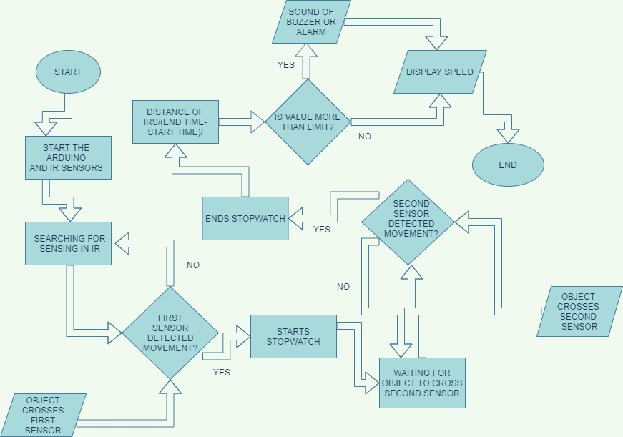
FLOWCHART

Slide 5
WORKING PROCEDURE
In this project, we have to calculate speed of any object using the distance traveled by that object. Here we have used Arduino UNO and IR sensor module is used to measure the speed.
At first we will take the speed limit for a specific object as user input.
Two IR sensors are placed at a certain distance. As soon as the object crosses two sensors, the time taken by the object to cross the distance is calculated.
Then the speed will be calculated by the Arduino.
If the measured speed is greater than the given speed limit, then it will make sound a buzzer. Otherwise only display the speed on LCD display.

Slide 6
FEATURES
A Virtual Terminal is used to receive the input speed limit from user.
IR sensor is used to detect the object and send the interrupts to Arduino.
Arduino receives input from the IR and virtual terminal and calculates the speed of the object.
LCD display displays the speed.
Potentiometer is used to control the display brightness of LCD.
If the measured speed is higher than the given speed limit, a buzzer alarms.

